Slide 1

Full-Stack Functional Fun

Slide 2
F#? What’s that?

Slide 3
“F# is a mature, open source, cross-platform, functional-first programming language. It empowers users and organizations to tackle complex computing problems with simple, maintainable and robust code.”
Notes:
This is a quote from the F# Software Foundation
What does it mean?

Slide 4
First class functions
Immutable-by-default
Rich type system
.NET
Notes:
These are the main benefits I see:
1)
Functional programming – concerned with functions as first class citizens.
Programs made of building blocks of pure functions, which take an input and return an output – no internal state.
Tends to be very declarative – programs built with declarations or expressions, rather than statements
Functions as first class citizens, rather than objects
2)
Avoid mutable state. Make your state updates explicit, helps with concurrency.
F# makes it very easy to define immutable state. Adds ceremony to mutable values.
3)
Type system enforces correctness – express business rules, such as nullability.
Can really express the domain – this is one of the main benefits, and one of the main takeways from this talk that I want you to apply to other languages.
4)
Made by MS. Runs on .NET – compiles down to the same thing as C#.
Make full use of the .NET ecosystem – easy to use ASP.NET, etc
Solid interop with C# - can still write OOP style code, classes etc.

Slide 5
  let square x = x * x
  let nine = square 3
  let sumOfSquares = List.sum (List.map square [1..100])
  let piped = [1..100] |> List.map square |> List.sum
Notes:
Function declarations
2) Type inference – infer arguments and return value of function
3) Pipe operator – compose functions. Build a pipeline out of smaller functions.
Functions are curried – instead of a function (x, y) -> z, you have x -> y -> z.

Slide 6
  type ContactMethod =
  | Email of string
  | Phone of phoneNumber: int * extension: int option
  type Person =
  { name: string
  contact: ContactMethod }
  let bob = { name = "Bob"; contact = Email "bob@example.com" }
  let sendMessage (person: Person) =
  match person.contact with
  | Email emailAddress -> sendEmail emailAddress
  | Phone (number, _) -> sendSms number
Notes:
Discriminated unions – can wrap strongly typed data types
Records – immutable data structures
See option type – indicates potential absence of value. Types are non-null.
Pattern matching – deal with data that has different shapes
Put these all together – can really model your domain.
Make it impossible to represent invalid state – eg enfornce nullability / non-nullability. Makes it easier for someone reading your code to understand your intention, reduces the chance of bugs.
This is one of the biggest benefits of F#

Slide 7
Let’s make a thing
With blackjack. And blackjack.
Notes:
At NDC, saw a talk on using F# for real world development.
Big benefit over other functional languages like Haskell – it’s possible to build real web apps with it.
Let’s make something. With Blackjack. And blackjack.

Slide 8
And we’re done!
Notes:
We’ve built the API. Send it through to UAT, go home.
But when you come into work the next day, the product owner has raised an issue. They think the user experience isn’t good enough – apparently they want a user interface.
You wish that they had mentioned that up front in the requirements.
It’s front-end, so we need to reimplement everything in Javascript in the browser. You sigh as you realise you need to re-implement all your code.

Slide 9
And we’re done?
Notes:
We’ve built the API. Send it through to UAT, go home.
But when you come into work the next day, the product owner has raised an issue. They think the user experience isn’t good enough – apparently they want a user interface.
You wish that they had mentioned that up front in the requirements.
It’s front-end, so we need to reimplement everything in Javascript in the browser. You sigh as you realise you need to re-implement all your code.

Slide 10
Fable to the rescue
Notes:
The F# community have you covered.
Fable is a tool that compiles F# code to Javascript.
So we can run F# in the browser!

Slide 11
Let’s talk state management

Slide 12
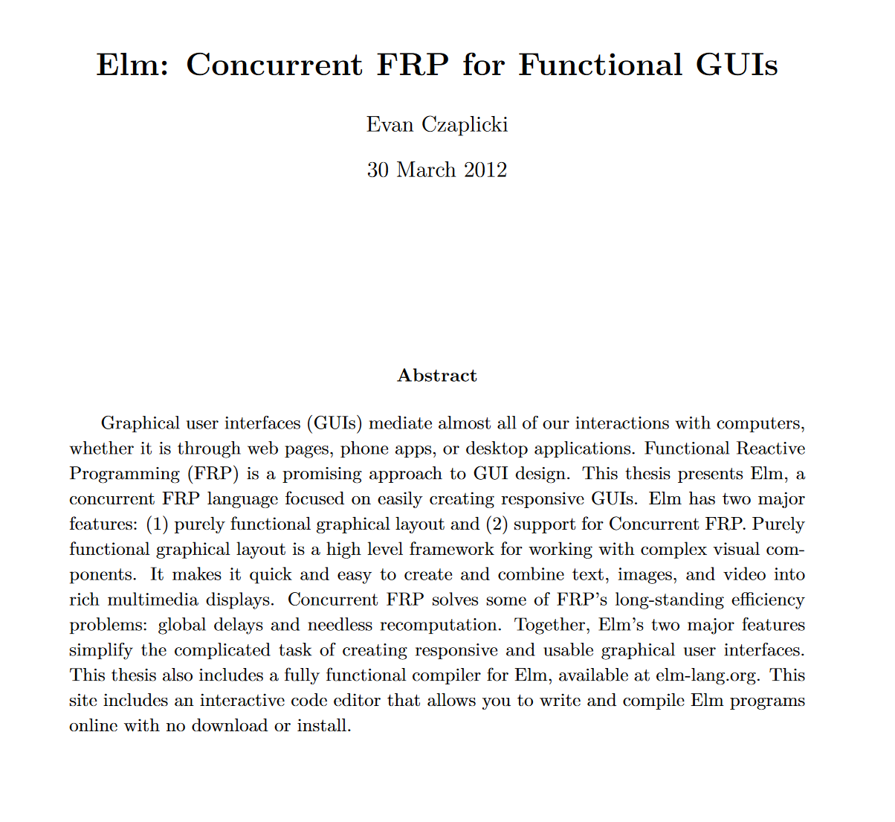

Slide 13
Model
Update
Message
Render
View
Dispatch

Slide 14
We’re done!

Slide 15
Putting it all together:
SAFE stack
Saturn / Giraffe
Azure
Fable
Elmish

Slide 16
Expressive types
Communicate intent; enforce validity
Restrictive types
Code sharing
Difficult boundaries
Top tier JS / .NET interop
JS interop required
Web-dev focused community
Small community
Notes:
Expressive type
Restrictive types – makes things like mutability hard – can make it hard to interop with other libraries, or to write performant code
No mutability means DDD is very hard
3. Difficult boundaries – you lose the type safety serialising into a DB. Discriminated unions don’t exist there
4. Code sharing
5. JS interop – really easy to consume JS libraries. Access to the full React ecosystem, and Webpack for bundling. Most other alternatives don’t use Webpack, have to reimplement the wheel
6. JS interop required – it’s still more painful than using TS.. Non-trivial to write type defs if you want to use existing libraries
7. Community is focused on solving real problems. Building tools to help web dev, not just pie in the sky like other functional languages.
8. Community is still small. Expect ot have to figure out stuff yourself

Slide 17
Would I recommend it?
Notes:
Yes, I think it works very well.
Main thing is I've had fun writing the code - it's really nice to write expressive code.
Definitely good for small apps, I prefer it to C# / JS for prototyping.
Main wekaness is needing to train up a team on it.
It would be my default functional language by far - it's got a far better ecosystem than other functional languages.

Slide 18
How can I learn F#?
https://fsharpforfunandprofit.com/
https://safe-stack.github.io/docs/intro/
https://adventofcode.com/

Slide 19
Questions?

